Slide 1
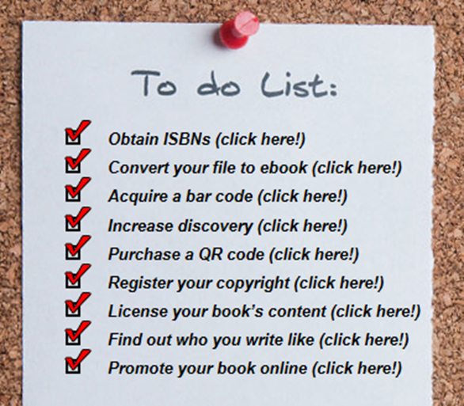
Rights, Copyrights, ISBN’s and Barcodes
By Rose Marie kern
7/12/24

Slide 2
ISBN International Standard Book Number
The International Standard Book Number (ISBN) is a numeric commercial book identifier which is intended to be unique. This keeps booksellers, libraries and others from confusing books which may have the same title.
An ISBN is assigned to each separate edition and variation (except reprintings) of a publication. For example, an e-book, a paperback, an audiobook and a hardcover edition of the same book may each have a different ISBN.

Slide 3
What is an ISBN really?
An ISBN is a number that identifies your book to merchants.
A company that manufactures Yellow Widgets wholesales them to many different retail outlets – each retail outlet puts their own price sticker on the widget.
An ISBN is a number that simply identifies your book like a price tag.

Slide 4
When do you need more than one ISBN per book? Each ISBN is unique and only refers to ONE specific version of your book and ONE specific publisher of the book. The hardback, paperback, audiobooks, and ebooks of one manuscript would all require different ISBN’s If it was originally printed by a traditional publisher but you now want to self-publish, or switch to a different publisher you need a new ISBN.

Slide 5
Why do I need an ISBN?
An ISBN improves the likelihood your book will be found and purchased
An ISBN enables more efficient marketing and distribution of your title
Most retailers require ISBNs
Correct use of the ISBN allows different product forms and editions of a book, printed or digital, to be differentiated clearly, ensuring that customers receive the version they require
The ISBN conveys no legal or copyright protection, however, the use of ISBNs for publications is prescribed by law in some countries
In some countries a book will be charged higher tax if it does not have an ISBN.

Slide 6
ISBN’s relationship to Barcodes
The Barcode is simply the “price sticker”
containing the ISBN code and publisher information which is needed for retail outlets to track sales.
Barcodes may show the price
but they don’t have to. This
gives authors more flexibility.
Barcodes are purchased at the same time you purchase an ISBN so they are linked.

Slide 7
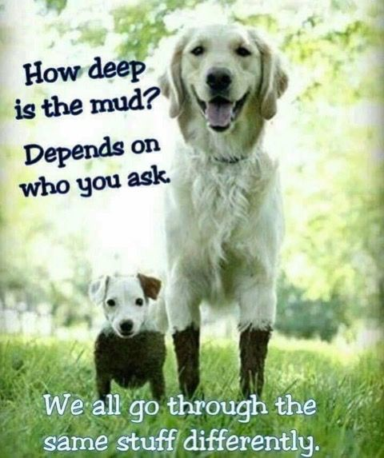
Where do I get an ISBN/Barcode?
If your book is being traditionally published, the company you use will purchase and attach the ISBN to your book – this allows them to keep track of sales and ensures that all copies of the book are purchased through them.
If you choose to self publish you can buy an ISBN directly from Bowker (see next slide)
Some self-publish assist companies like Ingram Spark will buy ISBNs/Barcodes in bulk and the author then purchases from them.
KDP Amazon provides ISBNs/Barcodes free to authors – but they are not valid outside of online sales through Amazon – you need your own if you plan to allow retail outlet sales.

Slide 8
Where do ISBN’s and Barcodes originate?
Every country in the world has ONE company which is authorized to issue ISBN codes. In the United States this company is BOWKER.
www.bowker.com

Slide 9
The United States ISBN Agency assigns ISBNs with the
Prefixes 979 and 978
What does this mean for publishers, libraries and retailers? As of January 2007, the 13-digit ISBN launched to increase the capacity of the ISBN system. 13-digit ISBNs are assigned by the U.S. ISBN Agency Currently, the U.S. ISBN Agency assigns ISBNs starting with either 978-0 or 978-1. The 0 and 1 indicate assignment by an ISBN Agency in an English-speaking region. The 979 assignments will start with 979-8.
The 8 is unique to the United States. Of course, as with the 978-0 and 978-1, an ISBN starting with 979-8 will allow U.S. publishers and self-publishers to market their books anywhere in the world

Slide 10
ISBN Information
An ISBN ensures your book’s information will be stored in the national BOWKER’s Books In Print database
Books In Print is consulted by publishers, retailers and libraries around world when searching for title information
Books In Print® is the leading bibliographic database for publishers, retailers and libraries around the world. From the enriched metadata that is supplied by publishers, Books In Print provides a valuable resource for retailers in the process of making smart purchasing decisions.

Slide 11
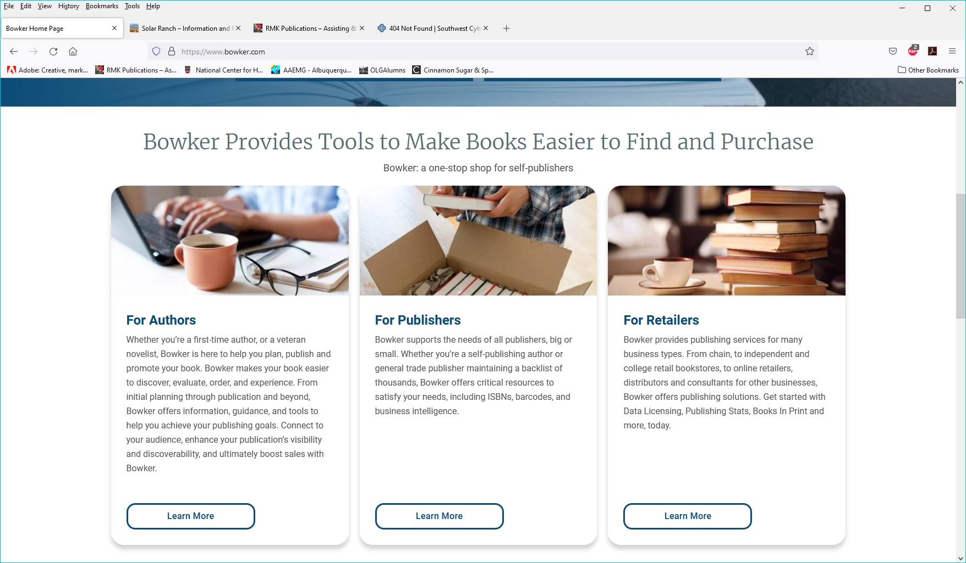
Don’t Be Fooled!
A lot of services buy bulk ISBN’s from Bowker then use clever weblinks to give you the idea that they are the place to get one – then in passing it to you they make it more expensive.
ISBNs and Barcodes can be purchased by individuals in bulk if they plan on using them for several different books.

Slide 12
Bowker prices for ISBN’s
ISBN $125.00
ISBN’s $295.00 ($29.50 each)
ISBN’s $575.00 ($5.75 each)
1000 ISBN’s $1,500.00 ($ 1.50 each)

Slide 13
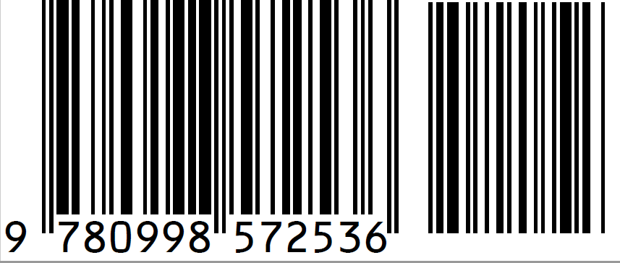
Universal Product Code (Barcode) UPC
What is a UPC / EAN Code?
UPC stands for Universal Product Code which is a specific 12-digit barcode allowing retailers to manage sales and inventory of a product.
UPC Codes are required for all general use products in the USA and Canada. EAN Codes are a 13-digit barcode that is valid in all countries. EAN stands for european article number.
A barcode is a method of representing data in a visual, machine-readable form. These barcodes, now commonly referred to as linear or one-dimensional, can be scanned by special optical scanners, called barcode readers.

Slide 14
Why do I need barcodes?
Most books or products that are to be sold in a retail outlet or through an online distributor needs a barcode to easily identify the product to the company’s scanners.
The trick is to make sure that your barcode is linked to the ISBN of your book ensuring instant identification.
Most publishers buy the ISBN’s and Barcodes together to keep the cost down.
Barcodes can be purchased from Bowker along with your ISBN.

Slide 15
Let’s Talk Rights
First Rights/Second Rights
Serial Rights
Reprint Rights
All Rights
COPYRIGHTS

Slide 16
FIRST RIGHTS
SECOND RIGHTS
SERIAL RIGHTS
REPRINT RIGHTS
These terms usually apply to short stories, magazine/news articles, poems or other short literary items.
*Most of these are not registered with the Library of Congress.

Slide 17
What are first North American serial rights?
First North American Serial Rights (First Rights) means that the magazine or book publisher has the legal right to publish the piece first in North American markets.
First Serial Rights work similarly, there is just no geographical limits.

Slide 18
First Rights vs Second Rights
Because most publishers want First Serial Rights, they expect you to have never published that work before.
A publisher normally pays for First Rights and may stipulate that the same story/poem/article cannot be sold to another entity for a period of time thereafter, usually between 6 months and a year.

Slide 19
Second Rights refers to the resale or free distribution
of the article after the First publication. It can be sold
or given away to multiple entities.
Example: I sell an article on Air Traffic Control to a national magazine and agree not to give it to anyone else for six months. After that time I can sell it or give it free to other magazines or newsletters, or publish it in a book.
NOTE: Just because you sell First Rights to one article/story/poem on a certain topic to a magazine does not keep you from writing/selling other articles about the same topic.

Slide 20
Reprint Rights mean that your work
has been published previously; the publisher
is acknowledging that, and they are asking
for the right to reprint your work.
What does publication mean? For some journals it means any publication (including a personal blog or Facebook page), while for others it means just that you affirm that your work has never been published before in any printed form.

Slide 21
Giving up ALL Rights
A license of All Rights is exactly that; the author is giving up all rights he or she owns in the work. The publisher may publish the work in any format -- print, film, electronic formats such as CD ROMs, and on the Internet without providing additional payment to the author.
The author retains the right to state that he or she authored the work, but loses all the other rights to the work, including the right to publish, market or distribute the work, to create derivative works, or to perform the work. This is standard when working with Traditional Publishing Houses and many Independent Publishers.

Slide 22
Copyright
A form of intellectual property law which protects original works of authorship including literary, dramatic, musical, and artistic works, such as poetry, novels, movies, songs, computer software, and architecture.

Slide 23
Copyright - Simply means you made and now you own it.
Your book is copyrighted the moment you put the words on paper which means it is protected upon creation of the work in virtually all countries, automatically. If you plan to register the copyright in a written work, you have to do that through the U.S. Copyright Office, at copyright.gov.
In the U.S., if you register your work and someone plagiarizes it, you are entitled to recover statutory damages without proving actual damages, and also recover attorneys’ fees if you successfully litigate your copyright infringement claim.
A Copyright is intended to protect the original expression of an idea in the form of a creative work, but not the idea itself.

Slide 24
Copyright is intended to protect the original expression of an idea in the form of a creative work, but not the idea itself.
Example: If you write a story about a flying elephant that lives on a spaceship, the copyright covers that particular story about that particular flying elephant – it does not mean that other people cannot write about flying elephants.

Slide 25
What is a Legal Copyright?
Your work is acknowledged to be your work from the time you set pen to paper or snap the picture – that is what copyright means.
Registering a copyright ensures that if someone else steals your work, you can prove that you thought it up and set it on paper before the other entity did.

Slide 26
Are you required to record a copyright with the Library of Congress?
NO. Most literary works do not need to be legally copyrighted. The work is considered to be the property of whoever can prove that the work belongs to them first.
Simple methods of proving you own the work.
You can show that you published it first.
Register it with the Writers Guild of America. Writers Guild of America West (wga.org)
Postal copyright - You put it into an envelope, mail it to yourself and store the unopened envelope – the cancellation date proves your ownership in a legal trial.

Slide 27
Do I have to legally copyright everything I write?
No. Many people do not bother to legally copyright every short story, poem, magazine article they write because of the expense.
Most people will copyright their books or screenplays if the information contained within is likely to tempt someone else to steal it.
This especially pertains to non-fiction research or technical materials and fiction that is written by really popular authors.

Slide 28
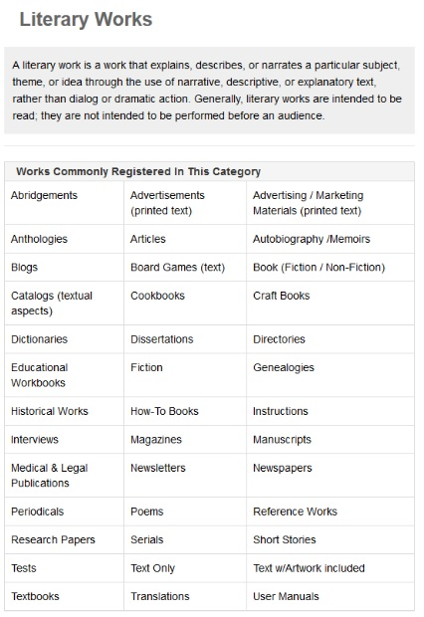
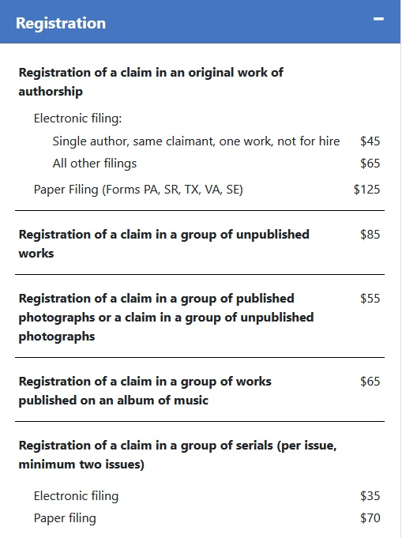
Library of Congress cost to Copyright

Slide 29
Registering your work with the Library of Congress is voluntary and not a requirement.
Advantages of doing so:
Legal evidence: This is the biggest and most significant benefit of getting a copyright registration done. With a copyright in place, your work is legally denoted to be yours. This keeps it safe. Knowing it is part of the National Archives
Public notice: When you copyright your work, it is documented in your name. Not only does this protect your work, it also gives you the ownership and spreads your name more freely in the public domain.
Seeking damages: Not only is plagiarism a threat to the economic health of your business, it is also a treat to your status and standing. So, if due to any unfortunate event you do end up in a copyright infringement tangle, you can seek damages from the perpetrators.
Locking it up: By copyrighting even a small item, you will make it inaccessible to your competitors.

Slide 30
How publishing your work interacts with your copyright :
“When I submit my work to a publisher do I get to keep my copyright?”
That it is the big question on most new authors’ minds. No publisher can ever take your copyright away without you signing a contract specifying that they are now the “owners” of your copyright.
Once you sign that contract, if in the future you want to take back your rights to a book, then you may have to pay for them to be returned.

Slide 31
What kinds of Books really should be copyrighted with the LOC?
Proprietary Research
Instructional Manuals
Very popular characters/novels by well known authors
Anything containing new/unique information
Historical texts with photographs
Any book that YOU want to have on file in the National Library of Congress!

Slide 32
Why is copyrighting with the Library of Congress good?
If there is a dispute as to who wrote/created something, this is the most legally respected method of proving it.
It legally prevents others from appropriating the work without permission.
You can begin the process before the book is completed to block others from stealing your ideas.

Slide 33
At What Point Should You legally Copyright?
You can request an LOC copyright up to a month before it is published or anytime after it is published.
You have one month to mail a finished printed copy or email a .pdf of the work to the Library of Congress
You can email the .pdf without the cover – just the work itself

Slide 34
Is the name/title of a book protected by copyright?
No. Names/Titles are not protected by
copyright law.
Some names may be protected under trademark law. Contact the U.S. Patent & Trademark Office.

Slide 35
Why send a book in .pdf form without the cover to the Library of Congress?
This means that you don’t have to acknowledge or include reviews/comments/artwork of anyone who adds to the cover in the copyright.
The Manuscript is what is important.

Slide 36
“I have written a series of books which I have never had copyrighted…can I pay one price and copyright them all at once?”
NO. You used to be able to do this, but the rules have changed. Now each book must be done and paid for separately.

Slide 37
If I send in a registration is the copyright automatically approved?
NO. The Library of Congress staff will scan key elements of the book to see if it infringes on another person’s work.
They will also check to see if someone in the book is quoted without being acknowledged as a contributor.

Slide 38
In the US and throughout most of the world, the default length of copyright is the life of the author plus 70 years. Be sure to name an heir to your copyrights in your will.
How long will my copyright be good for?

Slide 39
Should I re-copyright a book that I have updated?
Not unless there are major changes.
You can send in a manuscript then do some final edits and proofreading without having to copyright it all over again.

Slide 40
Can I register a work that has been previously copyrighted? If you are trying to copyright something you wrote while working for a company, or with someone else it may not be approved. This includes if you previously registered it to your own company.

Slide 41
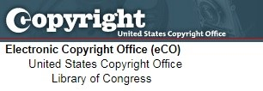
eco.copyright.gov
Library of Congress
Copyright website

Slide 42
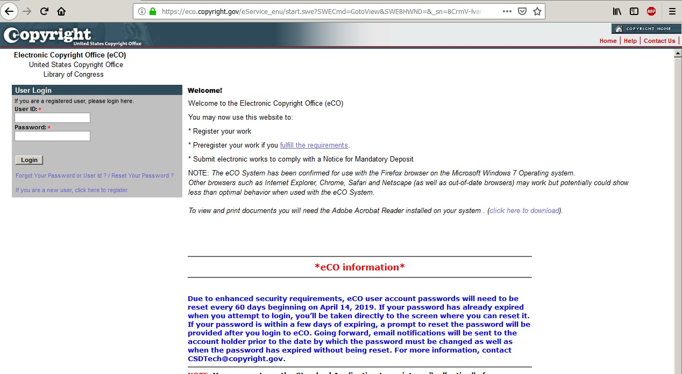
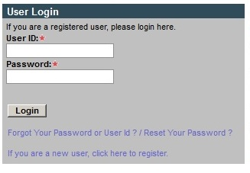

Slide 43
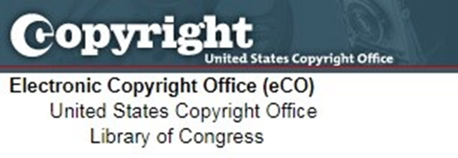
Password requirements:
1. Minimum password length must be eight characters and consist of at least two alphabetic characters and two non-alphabetic characters (numbers or special characters but NOT an ampersand - &).
2. A password cannot contain three of the same character.
3. A password must not be any of the 11 most recently used passwords for the account.
4. An account owner can change his or her password at any time, but at a maximum of once per day.

Slide 44
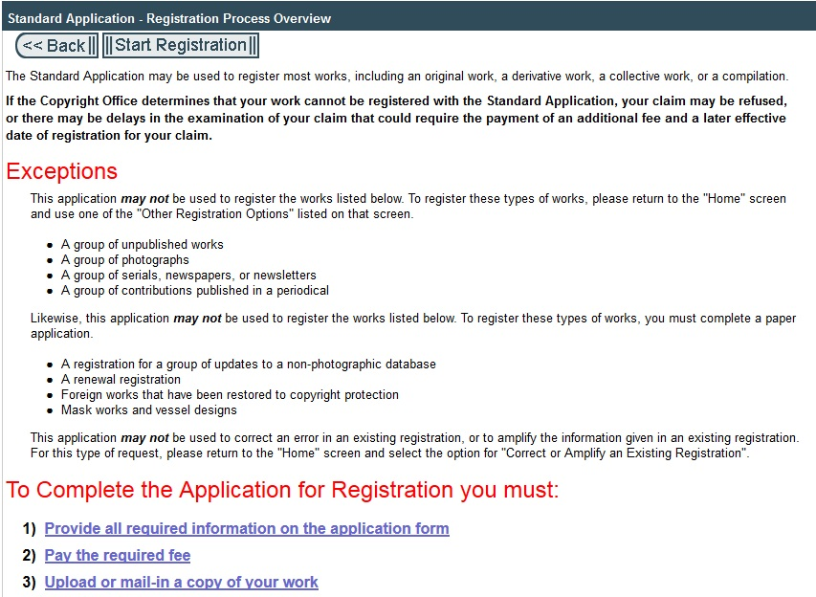

Slide 45
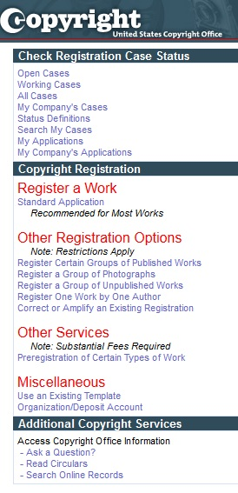
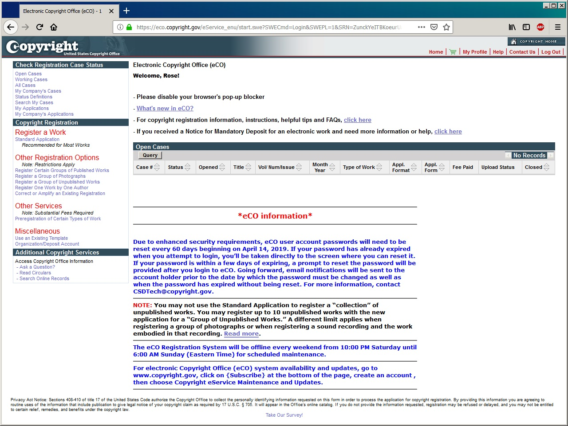
The Left Hand Menu has a lot of information, what we are doing today is simply a Standard Application which is used for a single book.

Slide 46
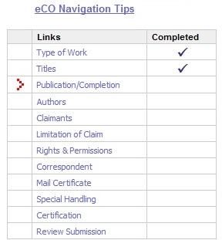
You are not done with application until all elements on the checklist are marked and payment made.
Clicking on each element hyperlinks you to that page.

Slide 47
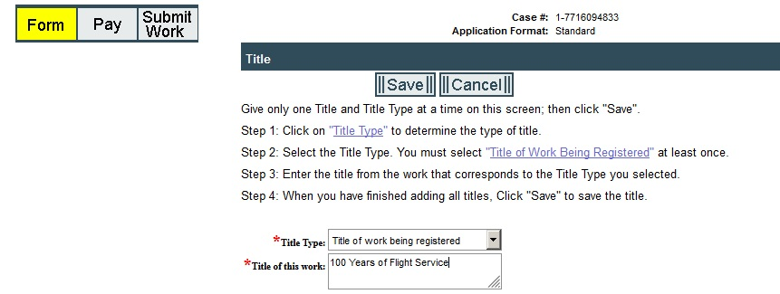

Slide 48
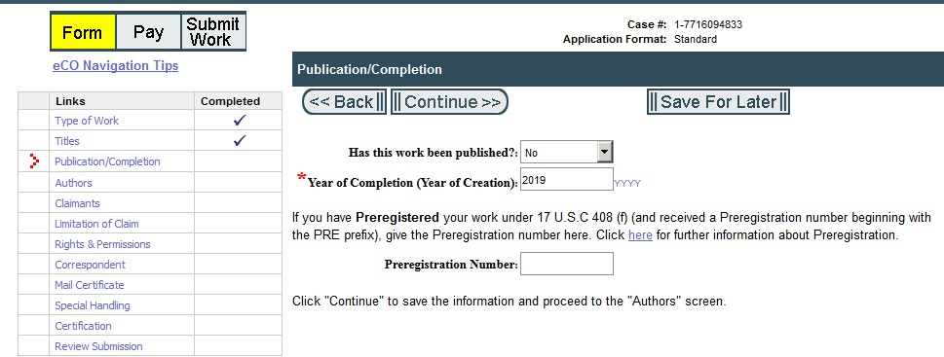

Slide 50
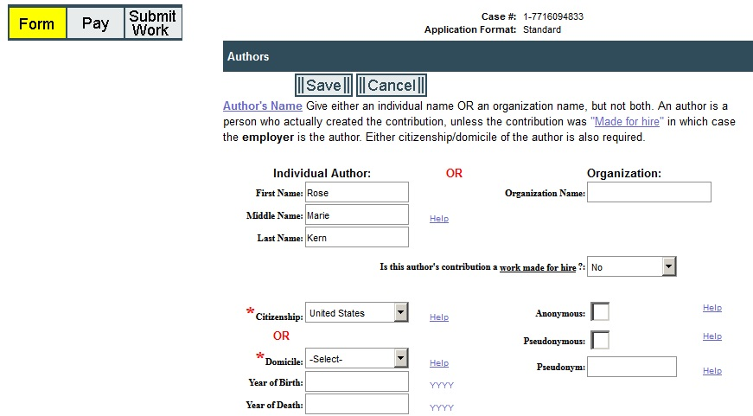
ONLY ONE of these two boxes must have information – if both do the screen will show ERROR.

Slide 51
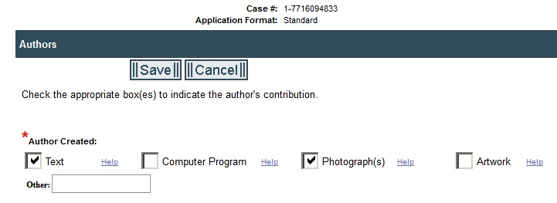
Check whichever boxes are appropriate if there is something else then add on bottom

Slide 52
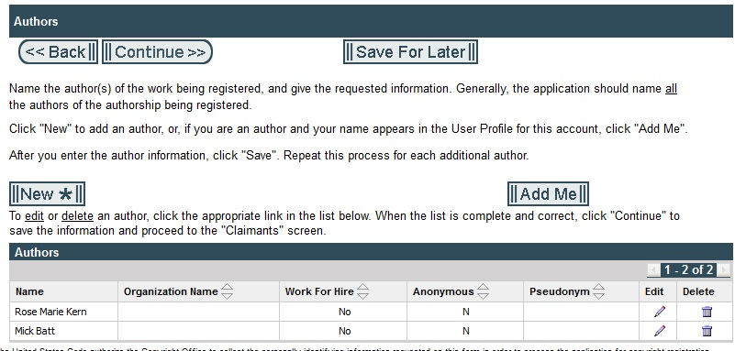
For Anthologies or if anyone is quoted in the book, their name must appear here.

Slide 53
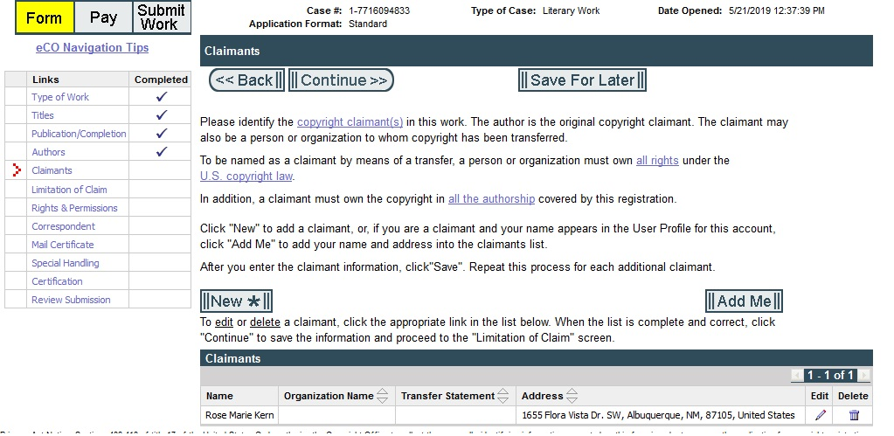

Slide 54
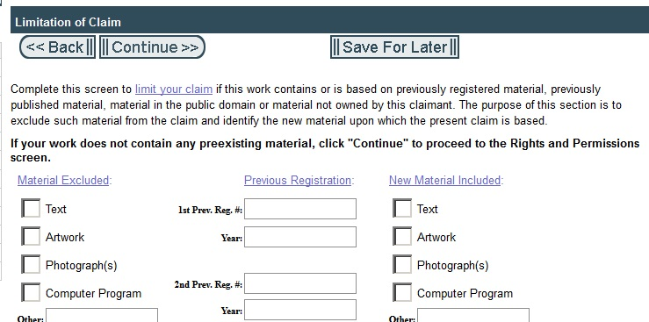

Slide 55
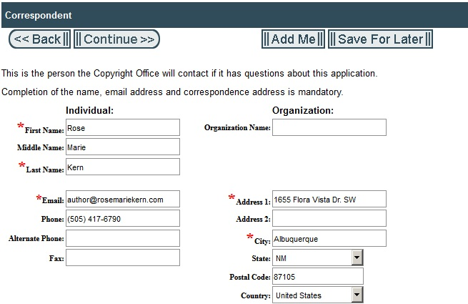

Slide 56
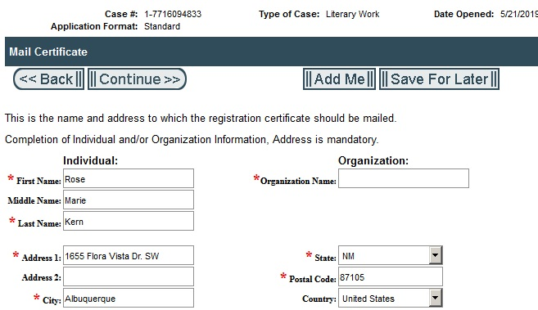

Slide 57
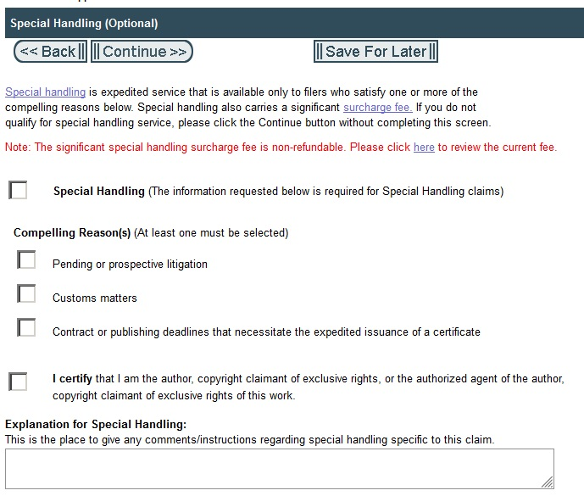

Slide 58
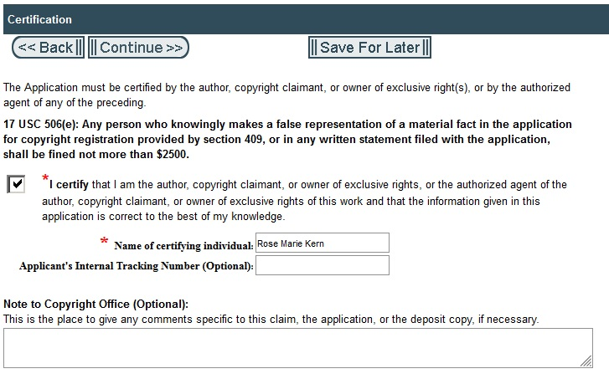

Slide 59
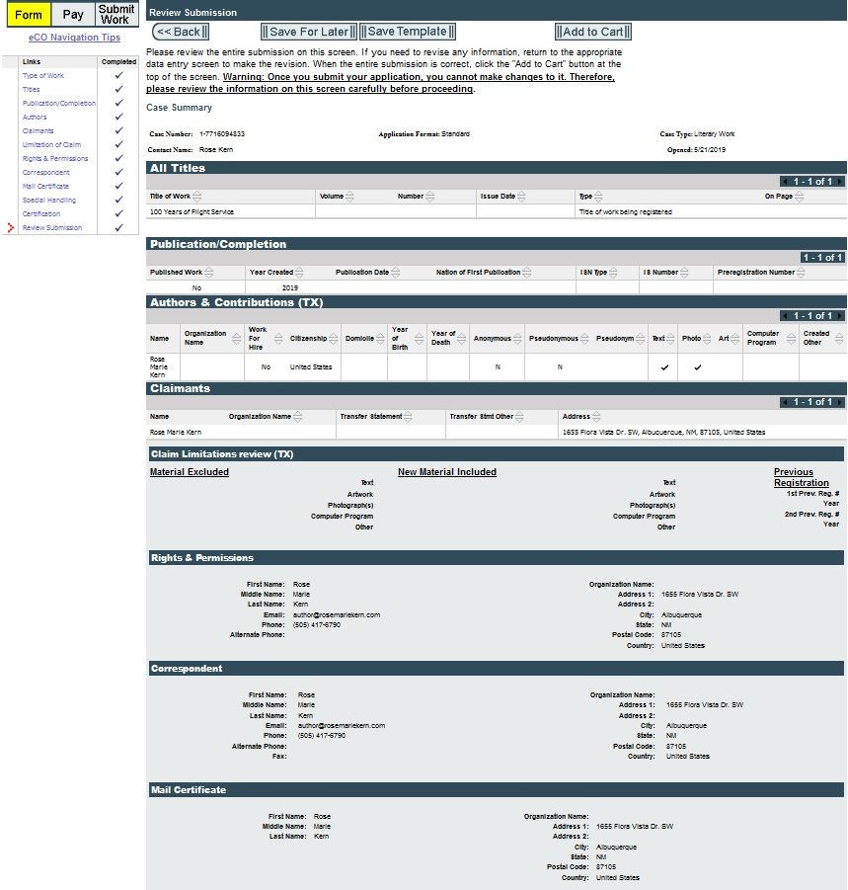

Slide 60
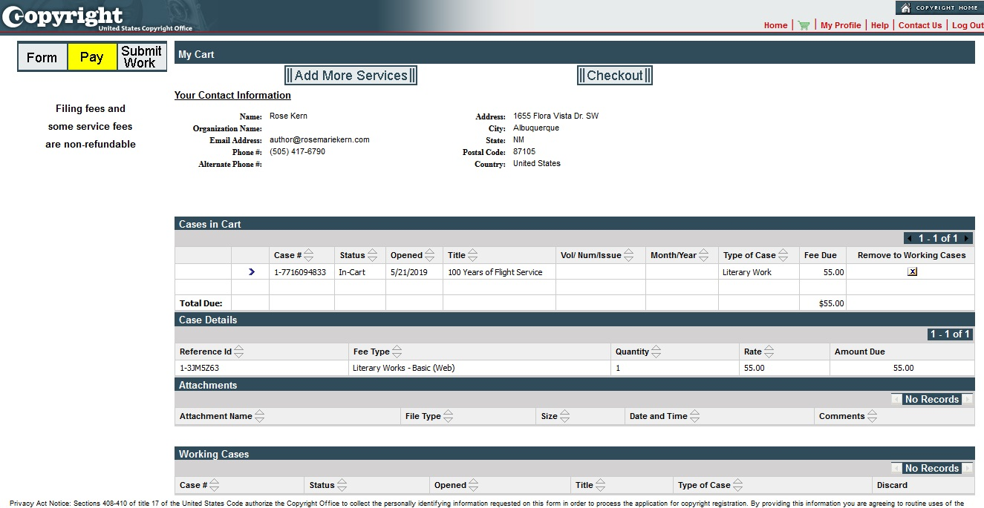

Slide 62
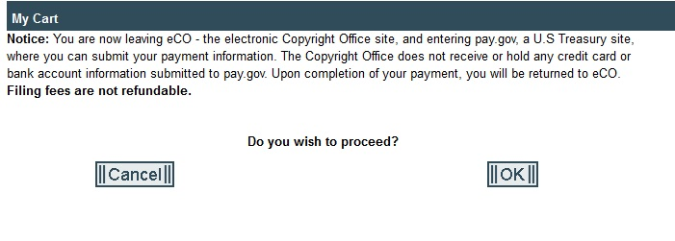
This transfers you to a totally different site to pay for the Copyright.

Slide 63
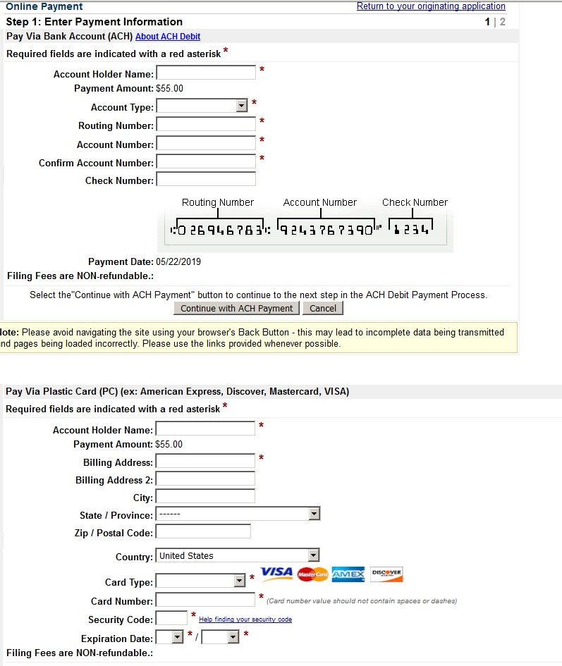

Slide 64
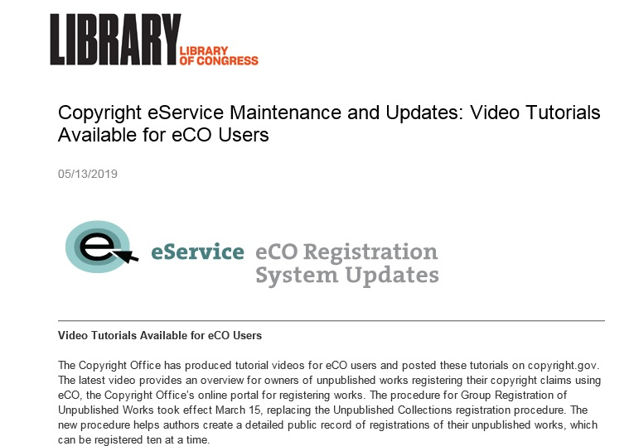
Once you are registered with the Library of Congress, they will send information and updates related to copyrights on a regular basis.

Slide 65
Alternate method of proving your copyright.
Writers Guild of America West.
WGA is important for scripts but book writers who think their book would make a great screenplay and want to protect their creative work can make an outline or synopsis or treatment and register that. Info below. When you register your script prior to submitting it to contests, agents, managers, or producers, you document your authorship on a given date should there be unauthorized usage.
Writers Guild of America West (wga.org)
Registering your work with the WGAW Registry documents the claim of authorship of a written work and does NOT take the place of registering with the Library of Congress, U.S. Copyright Office which primarily documents the ownership or rights of written work.

Slide 66
More Information can be found at:
https://eco.copyright.gov
https://revisionlegal.com/copyrights/registration-denial
https://www.newmediarights.org/business_models/artist/what_copyright_law_who_created_it_and_why_do_people_think_we_need_it

Slide 67
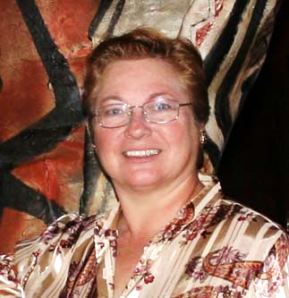
A pdf of this presentation by
Rose Marie Kern Is available on her website:
www.rmkpublications.com

